Slide 1
The Next Generation: Innovating with AI

Slide 2
Education. The Final Frontier. These are the voyages of the starship Curriculum. Its ongoing mission: To explore strange new worlds, To seek out new life and civilizations, To boldly go where no one has gone before.

Slide 3
The Next Generation
Innovating with AI

Slide 4
Starring
Dennis Becker
as
The Captain

Slide 5
Jamaal Ahmed
as
Sr. Associate Registrar

Slide 6
Also Starring
Chad Saunders
as
Degree Audit Analyst

Slide 7
Wenguo Edmans
as
Web/Computer Systems Specialist

Slide 8
Jane Lavery
as
Student Systems Analyst

Slide 9
Dan Saunders
(No relation)
as
Student Systems Analyst

Slide 10
Bianca Kumar
as
Continuing Education Analyst

Slide 14
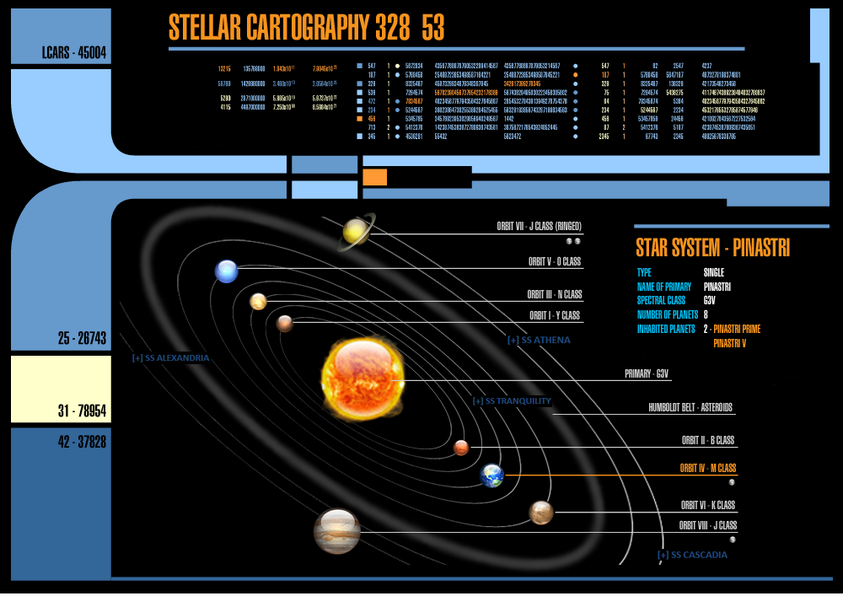
AGENDA
Overview of AI
Value as a tool
Examples of usage
Conclusion

Slide 15
Overview
Artificial intelligence (AI) can broadly be classified into two main types: narrow AI and general AI. These categories help distinguish between the various capabilities and functionalities of AI systems.

Slide 16
Narrow AI
Narrow AI refers to AI systems designed to perform a specific task without genuine intelligence or consciousness. These systems operate within a limited context and cannot perform beyond their programmed area. They are called "narrow" because their intelligence and capabilities are focused on specific, narrow tasks.
Examples of Narrow AI:
Siri and Alexa: These are voice-activated assistants that can perform tasks like setting reminders, playing music, or providing weather updates based on specific commands.
Recommendation Systems: Used by platforms like Netflix, Spotify, and Amazon to suggest movies, music, or products based on user preferences and past behavior.
Image Recognition Software: Used in various applications from photo tagging on social media platforms to diagnostic systems in healthcare that analyze images to identify diseases.
Autonomous Vehicles: These use AI to navigate and avoid obstacles, but are limited to the driving domain and are not capable of performing tasks outside it.

Slide 17
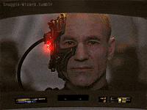
General AI
General AI refers to AI systems that possess the ability to understand, learn, and apply intelligence across a broad range of tasks, mimicking human cognitive abilities. General AI can theoretically reason, solve problems, make judgments, plan, learn, and communicate in natural language. This type of AI does not yet exist and is considered a goal for the future of AI research.
HAL 9000 (2001: A Space Odyssey):
Description: HAL 9000 is a highly intelligent computer system capable of performing a wide range of tasks, from managing spacecraft operations to conversing with humans and making complex decisions.
Capabilities: HAL exhibits human-like reasoning, decision-making, and natural language processing.
J.A.R.V.I.S. (Iron Man Series):
Description: J.A.R.V.I.S. (Just A Rather Very Intelligent System) is Tony Stark's AI assistant. It manages various systems in Stark's life, including his Iron Man suits, home automation, and data analysis.
Capabilities: J.A.R.V.I.S. demonstrates advanced problem-solving, conversational abilities, and control over complex technology.
Skynet (Terminator Series):
Description: Skynet is a self-aware AI system that controls a global network of machines and robots. It can learn, adapt, and make autonomous decisions.
Capabilities: Skynet possesses strategic thinking, self-preservation instincts, and the ability to control various machines and weapons systems.

Slide 18
AGENDA
Overview of AI
Value as a tool
Examples of usage
Conclusion

Slide 19
VALUE AS A TOOL
The value in using AI as a tool for work lies in its ability to enhance productivity, improve efficiency, and provide insights.
AI can automate repetitive tasks
Analyze large amounts of data quickly, and offer personalized recommendations, freeing up human workers to focus on more complex and creative tasks.
AI can assist in decision-making by identifying patterns and trends that might not be immediately evident to humans, leading to better-informed business strategies and outcomes.

Slide 20
VALUE AS A TOOL
By leveraging products from companies, a registrar's office can improve efficiency, enhance student services, and make informed, data-driven decisions.
Automating routine tasks
Data analysis and reporting
Enhanced student services
Improved document management
Operational efficiency

Slide 21
VALUE AS A TOOL
1. Automating Routine Tasks:
Transcript Processing:
Parchment: Offers transcript services including processing, delivery, and tracking.
National Student Clearinghouse: Provides automated transcript ordering and delivery services.
Course Registration:
Ellucian Banner: Provides comprehensive solutions for course registration and enrollment management.
PeopleSoft Campus Solutions (Oracle): Offers course registration and student information system management.

Slide 22
VALUE AS A TOOL
2. Data Analysis and Reporting:
Predictive Analytics:
Civitas Learning: Provides predictive analytics tools to improve student success and institutional outcomes.
Rapid Insight: Offers data analytics and predictive modeling solutions for higher education.
Performance Tracking:
Starfish by Hobsons: Helps track student performance and identify at-risk students for early intervention.
EAB Navigate: Provides student success management systems with performance tracking features.
and predictive modeling solutions for higher education.

Slide 23
VALUE AS A TOOL
3. Enhanced Student Services:
Chatbots and Virtual Assistants:
Ivy.ai: Provides AI-driven chatbots for higher education institutions to handle student inquiries.
Admission’s Chatbot (Ocelot): Offers AI-powered chatbots for student services and support.
Personalized Advising:
Advising by EAB Navigate: Offers tools for personalized academic advising and student support.
Civitas Learning: Provides data-driven insights for personalized student advising and interventions.

Slide 24
VALUE AS A TOOL
4. Improved Document Management:
Document Digitization:
Hyland OnBase: Offers enterprise content management solutions for digitizing and managing academic records.
Laserfiche: Provides document management and automation solutions for higher education.
Compliance and Audits:
Compliance Assist by Campus Labs: Helps manage accreditation, assessment, and compliance requirements.
Qualtrax: Offers compliance management software to ensure regulatory adherence and facilitate audits.

Slide 25
VALUE AS A TOOL
5. Operational Efficiency:
Scheduling Optimization:
Ad Astra: Provides scheduling and resource management solutions to optimize class schedules and room assignments.
CollegeNET: Offers tools for academic scheduling, event management, and room scheduling.
Resource Allocation:
Workday Student: Offers cloud-based solutions for student administration, including resource allocation.
Ellucian Banner: Provides tools for efficient allocation of staff and resources based on institutional needs.

Slide 26
AGENDA
Overview of AI
Value as a tool
Examples of usage
Conclusion

Slide 27
EXAMPLE 1
I need to plan my week. I have a 3 hour total project that requires focus, a meeting on Wednesday from 1-2, a meeting on Monday and Thursday that can’t be moved from 2:30-4:30. Find an optimal time in my week on one day so I can knock out the project and still allow time for mental health breaks. Layout the whole week.

Slide 28
EXAMPLE 2
I am not in the best mood and need to change the tone to be more professional. Rewrite this email:
Hey John,
After 3 years you still do not understand the basics of the degree audit system. I’m tired of having to constantly tell you the same thing. It’s like you don’t even care about actually doing the work yourself and expect me to do it for you. I’ve told you multiple times to double-check the student data and the catalog year. This is unacceptable. If you keep this up, we’re going to have a serious problem because you are wasting my time.
Figure it out. I don’t have time to babysit you and your work.
Get it together.
Thanks,
Chad

Slide 29
EXAMPLE 3
Take the role of a degree audit analyst in the office of the registrar at a university. I am having trouble with the information in my training on my university’s degree audit system. If seems like the information is not setting in to advisors who use the system. Help me create a new training timeline that covers an academic year. At minimum I think I want to include monthly webinar if that is a good idea.

Slide 30
EXAMPLE 4
Take the role of a registrar at a university.
*Create a short test for a new employee that centers on FERPA
*Create a multiple choice test about FERPA for a new employee
*Create an executive level test about FERPA for use to certify
management staff in a registrar office

Slide 31
EXAMPLE 5
Translate this email into Spanish.
Hi John,
I hope you're doing well.
I wanted to touch base regarding the recent degree audit reports. It seems there are still some recurring issues with understanding the basics of the degree audit system, particularly concerning the accuracy of student data and the catalog year. Given your experience, I believe we can address these effectively.
Could you please review the latest report and correct the identified errors? Double-checking the student data and catalog year before submission is crucial to ensure accuracy.
If there's anything specific you're finding challenging or if additional training would be helpful, please let me know. I'm here to support you in any way I can to ensure we meet our high standards.
Thank you for your attention to this matter.
Best regards,
Chad

Slide 32
EXAMPLE 6
Take the role of a registrar at a mid-sized private university, Saunders University. I want to revamp my departmental mission statement to be customer service focused.
Browse other comparable registrar pages.
Boston College, Gonzaga University, Syracuse University,
University of Colorado at Boulder, Colorado State University,
University of Vermont, and the University of Miami
are schools for comparison.
Generate 3 examples of possible mission statements.

Slide 33
EXAMPLE 7
Summarize this article and provide highlights:
https://www.edweek.org/policy-politics/the-topic-that-didnt-get-a-single-mention-in-biden-trump-debate/2024/06

Slide 34
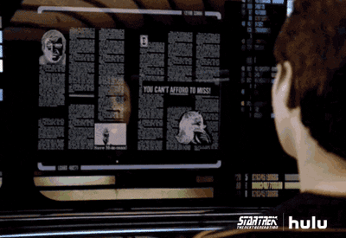
EXAMPLE 8
Analyze this data.
Provide basic descriptive stats including frequencies across and within years.
Indicate changes and provide observations and a summary.
Show any inconsistencies before correcting.
Generate a graphic of the data.

Slide 35
AGENDA
Overview of AI
Value as a tool
Examples of usage
Conclusion

Slide 36
Conclusion
Embracing AI in the registrar's office revolutionizes how we manage and streamline academic processes. By leveraging AI technologies, we can enhance accuracy, improve efficiency, and provide exceptional customer service. This innovation not only optimizes resource allocation but also empowers staff to focus on more strategic and student-centered initiatives, ultimately fostering a more responsive and agile educational environment. The future of registrar services is bright with AI, enabling us to meet the evolving needs of our academic community with greater precision and care.

Slide 37
Chad Saunders, MA
Degree Audit Analyst, Office of the Registrar
Doctoral Student, Morgridge College of Education
President-Elect, Rocky Mountain Association of Collegiate Registrars
and Admissions Officers (RMACRAO)
American Association of Collegiate Registrars and Admissions Officers (AACRAO)
Advancing Racial Equity Advisory Group
University of Denver Staff Senator-Area 8
Chad.saunders@du.edu
303-871-4996

