Slide 1
Banner Student Information System Users Roundtable
July 11, 2024 4:10-5pm session
Host: Jamie Yarbrough, Associate Registrar SIS Operations

Slide 2
Potential Topics
Licensure Disclosures
Gainful Employment/FVT
Ethos
Ellucian Experience
Ellucian SaaS
Preferred Pronouns
Gender Identity
Preferred Name
Quality Control of Releases
Upgrade Testing
Ellucian Workflow
Banner Communication Management
Tips and Tricks

Slide 3
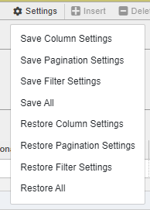
Preferred Settings

Slide 4
Column Settings
Change the order that columns appear on the page
Great for skipping columns that you don’t need and putting critical ones close together.
Can be challenging if you’re creating documentation for others to reference.
Change the column width
Great for shrinking columns that are unnecessarily wide.
Changed columns have a blue shading in the header

Slide 5
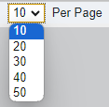
Pagination Settings
Change number of rows displayed per page

Slide 6
Filter Settings
Create the Filters you want, per page
Set what fields you typically need for searches
Set the values for those searches
Example: SSASECQ – Schedule Section Query

Slide 7
Default
New Filter

Slide 8
Restore Settings
Don’t like the settings, no problem!
There are options to restore to the system
defaults at any time.

Slide 9
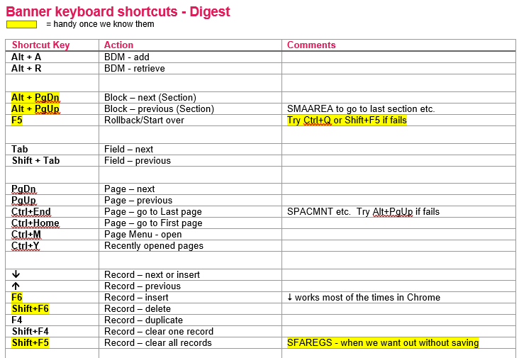
Banner Keyboard Shortcuts

Slide 10
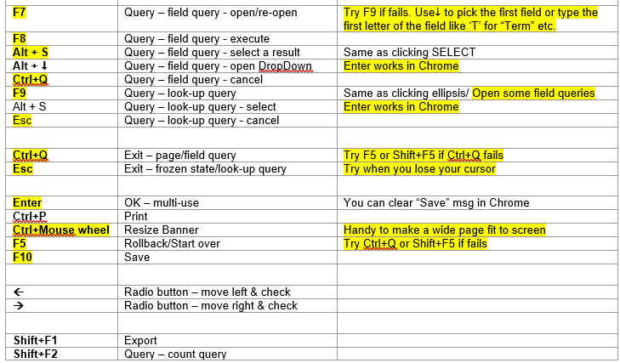
Banner Keyboard Shortcuts

Slide 11
Thank You

