Slide 1
The adventure in launching an asynchronous online FERPA Training for your campus
Presented by: Dr. Henrietta Romero, University Registrar
New Mexico Highlands University
Las Vegas, New Mexico

Slide 2
FERPA training campus wide is the Best part of annual ferpa compliance
How do you train your campus each year?
What is your response rate?

Slide 3
Being a Registrar/FERPA Compliance Officer is easy it’s like riding a bike. Except the bike is on fire and you’re on fire, everything's on fire!

Slide 4
The adventure at NMHU

Slide 5
Asynchronous online FERPA Training at NMHU
The idea developed in 2022 after over a dozen of in-person and synchronous virtual FERPA trainings were delivered to our campus community.
What was the goal? To give the campus community the opportunity to take the annual FERPA training within a time frame at their own leisure and pace.
Who did we work with to get this going?
Office of the Registrar
Provost/Vice President for Academic Affairs
Faculty Senate
ITS
Human Resources

Slide 6
Steps to launch the Annual FERPA Training
Our team reached out to ITS to create a course within our LMS that was available to all active employees (staff, faculty, student employees)
Used our existing LMS
Tied the enrollment of the course to our current HR data in Banner and used that data to auto enroll participants for the training.
Use HR Data to Determine Participants
Reviewed response rates during two periods in October and March of each year. This helps us ensure that any new employees that joined the institution in those months would have the opportunity for completion.
Monitored the Response Rates

Slide 7
Data since the launch
Academic Year | Total Enrolled | Completion Rate | Failure Rate | Not Completed
2022-2023 | 993 | 65% | 4% | 31%
2023-2024 | 1563 | 56% | 2% | 42%
Average | 2060 | 58% | 2% | 40%
2022-2023 metrics
644 completed/passed (pass rate 70% or higher)
306 not completed
43 failed the online exam with training
2023-2024 metrics
872 completed/passed (pass rate 70% or higher)
662 not completed
29 failed the online exam with training

Slide 8
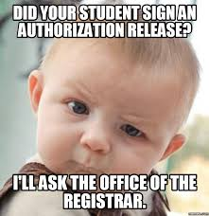
Now what? How do we improve the process?
We have streamlined the process to close the training at 3 points in the year, October, March and July
This gives us ample time to work with Human Resources and respective departments to inform them of the staff/faculty or student employees that still need training completed with a new deadline for completion.
Revised our certificates to expire
Each employee after completion of the training will receive a training certificate for the academic year to display in their office or give to their supervisor for their employee file.

Slide 9
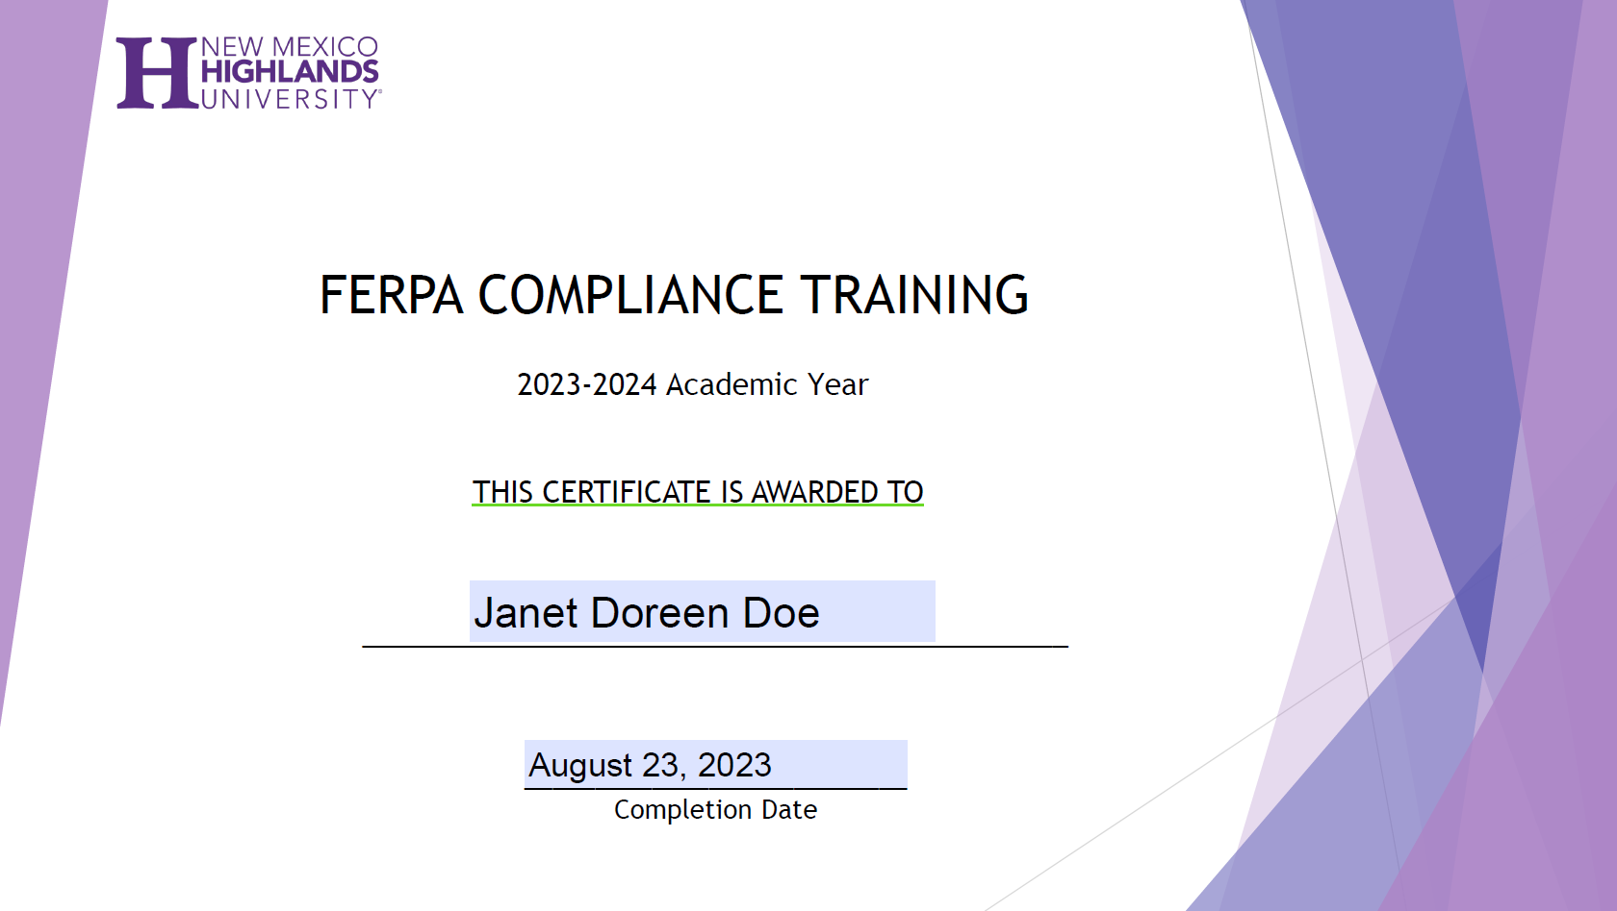
Sample Training Certificate that is automatically generated from our SIS after successful completion

Slide 10
It’s Not perfect but we continue to improve
We hope to market and inform the campus community within enough time about the training to garner better response rates.
We are working on an automated system of notification via email to complete the training if they have not.
We have also established a direct report to our faculty Academic Affairs and Faculty Senate to inform our faculty on campus and at a distance of the need to complete the training.
Human Resources is launching a new on-boarding process and is using this a requirement for all new hires during the on-boarding process.

Slide 11
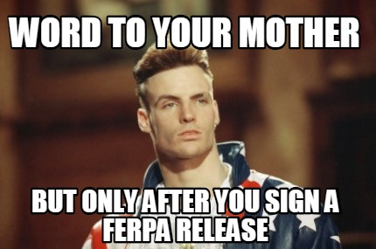
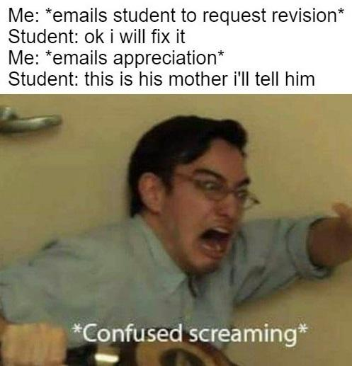
Questions!

Slide 12
Thank you for attending!

